Slide 1

Model-based Engineering for Quadcopter Control Software
Vrushank Agrawal
Advisor: Timothy bourke
Co-Advisor: Basile Pesin

Slide 2

Introduction
2
Quadcopter
Unmanned Aerial Vehicle and a type of drone
Embedded System which uses
RTOS
parallelism
works with time constraints

Slide 3
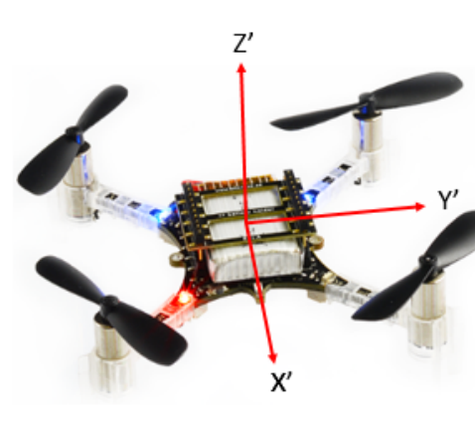
Quadcopter Movement
3
6 Degrees of Freedom (DOF)
4 State Variables
Thrust
Roll
Pitch
Yaw

Slide 4
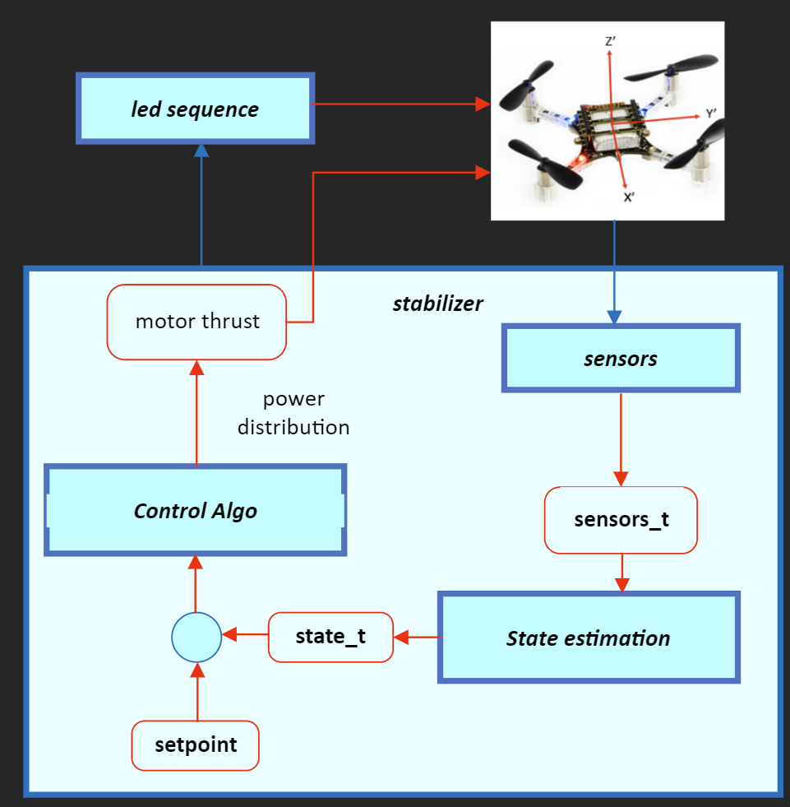
Crazyflie system design
4
A combination of tasks that run parallelly on the microcontroller
Led sequence for setting the leds
Feedback control loop
Takes sensors’ input
Gives controlled input to the hardware

Slide 5
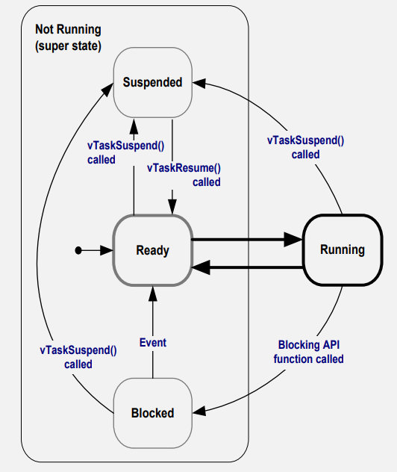
FreeRTOS Scheduler
5
FreeRTOS
Task states in FreeRTOS
Preemptive scheduler
Idle Task

Slide 6
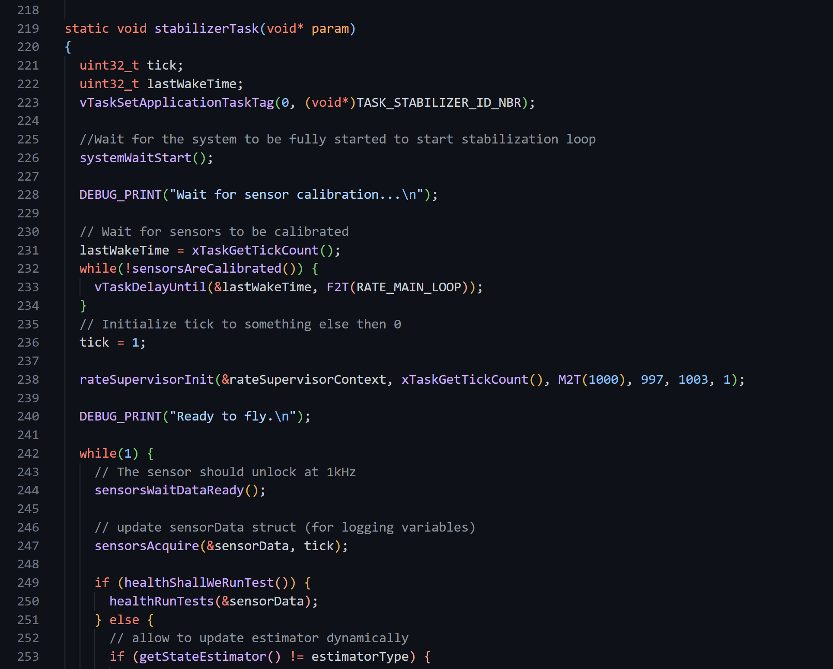
Problem
6
Quadcopters written in C/C++ from initial state diagrams
Hard to understand the code and model and test system behavior

Slide 7
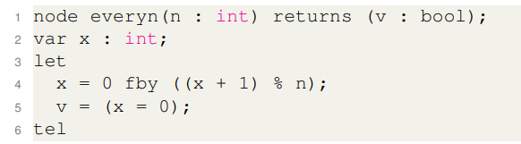
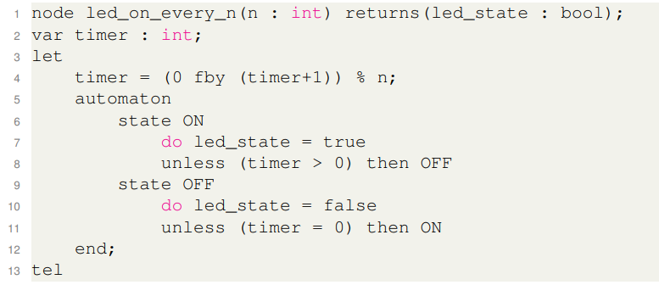
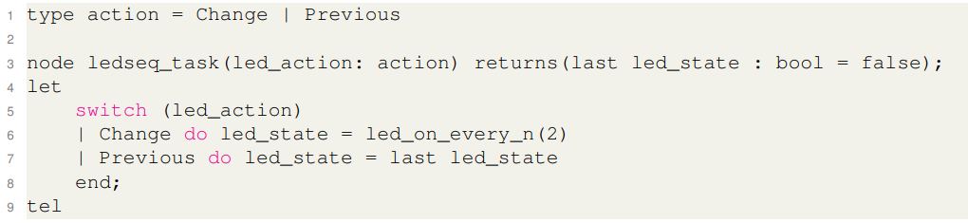
7
Alternative Approach
Write the code in a Dataflow Synchronous Language like Heptagon
Inspired from Lustre and offers modern features like delays, automata, switch

Slide 8
8
Our Goal
Write parts of the Crazyflie source code (written in C) in Heptagon
The thesis is in continuation with CSE303 project which was dedicated to understanding the Crazyflie source code
PID controller already implemented by colleagues, so, integrate and test the integration in Crazyflie.
Implement state estimation, led sequence task, and Kalman task in Heptagon

Slide 9
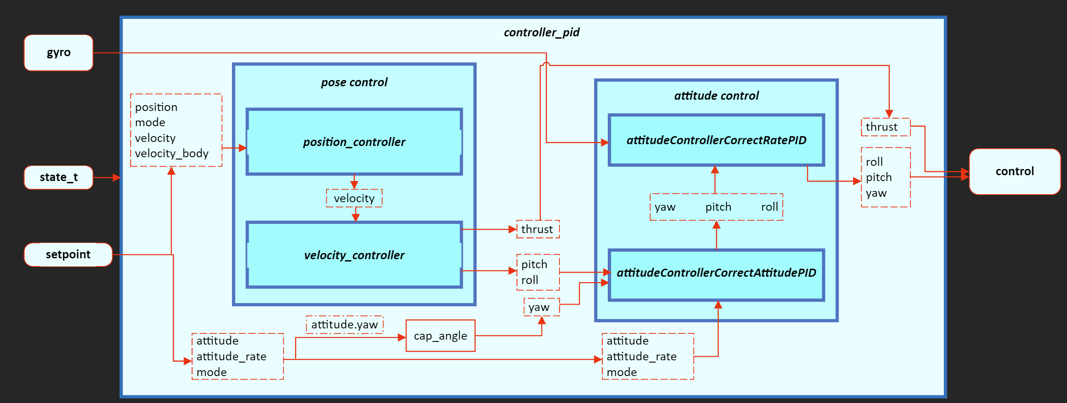
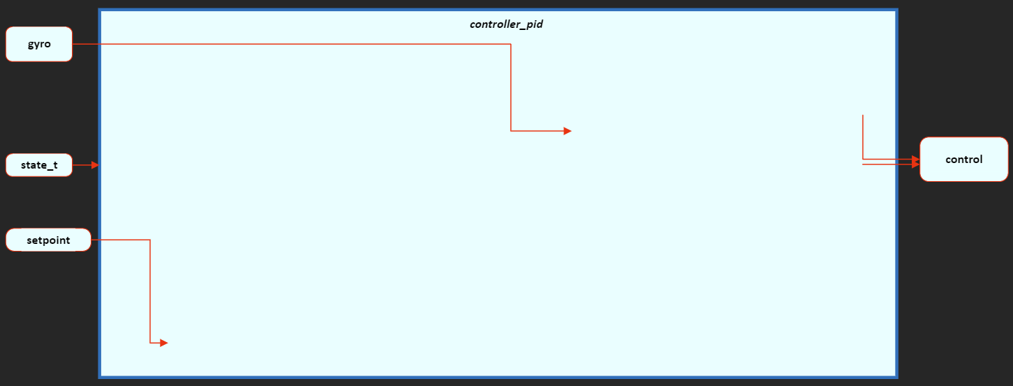
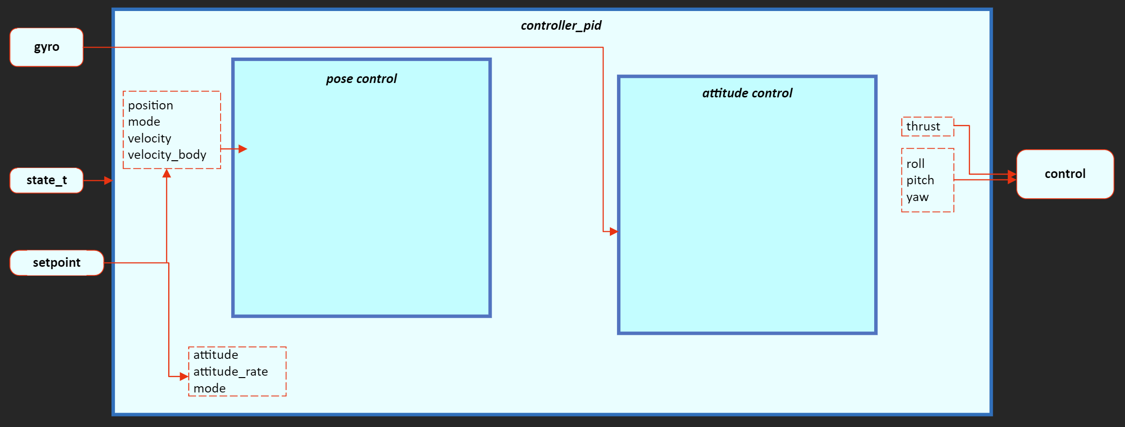
Cascaded PID Controller Dataflow diagram
9

Slide 10
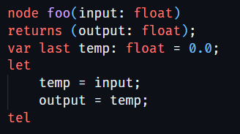
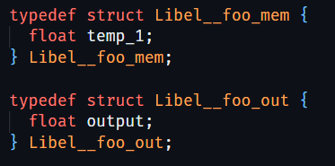
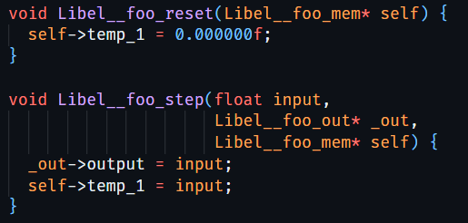
Merging Heptagon-generated C code
10
For every node, Heptagon generates two data types:
mem - contains reference to the current state
out - contains output of node.
And two types of functions :
reset – initializes temporary variables used in the node
step – evaluates code of the Heptagon node

Slide 11
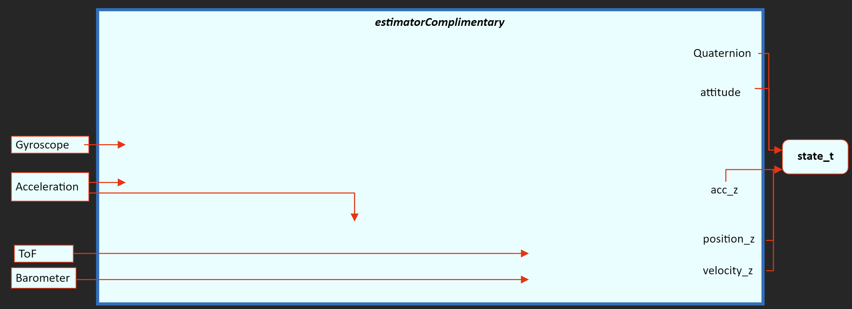
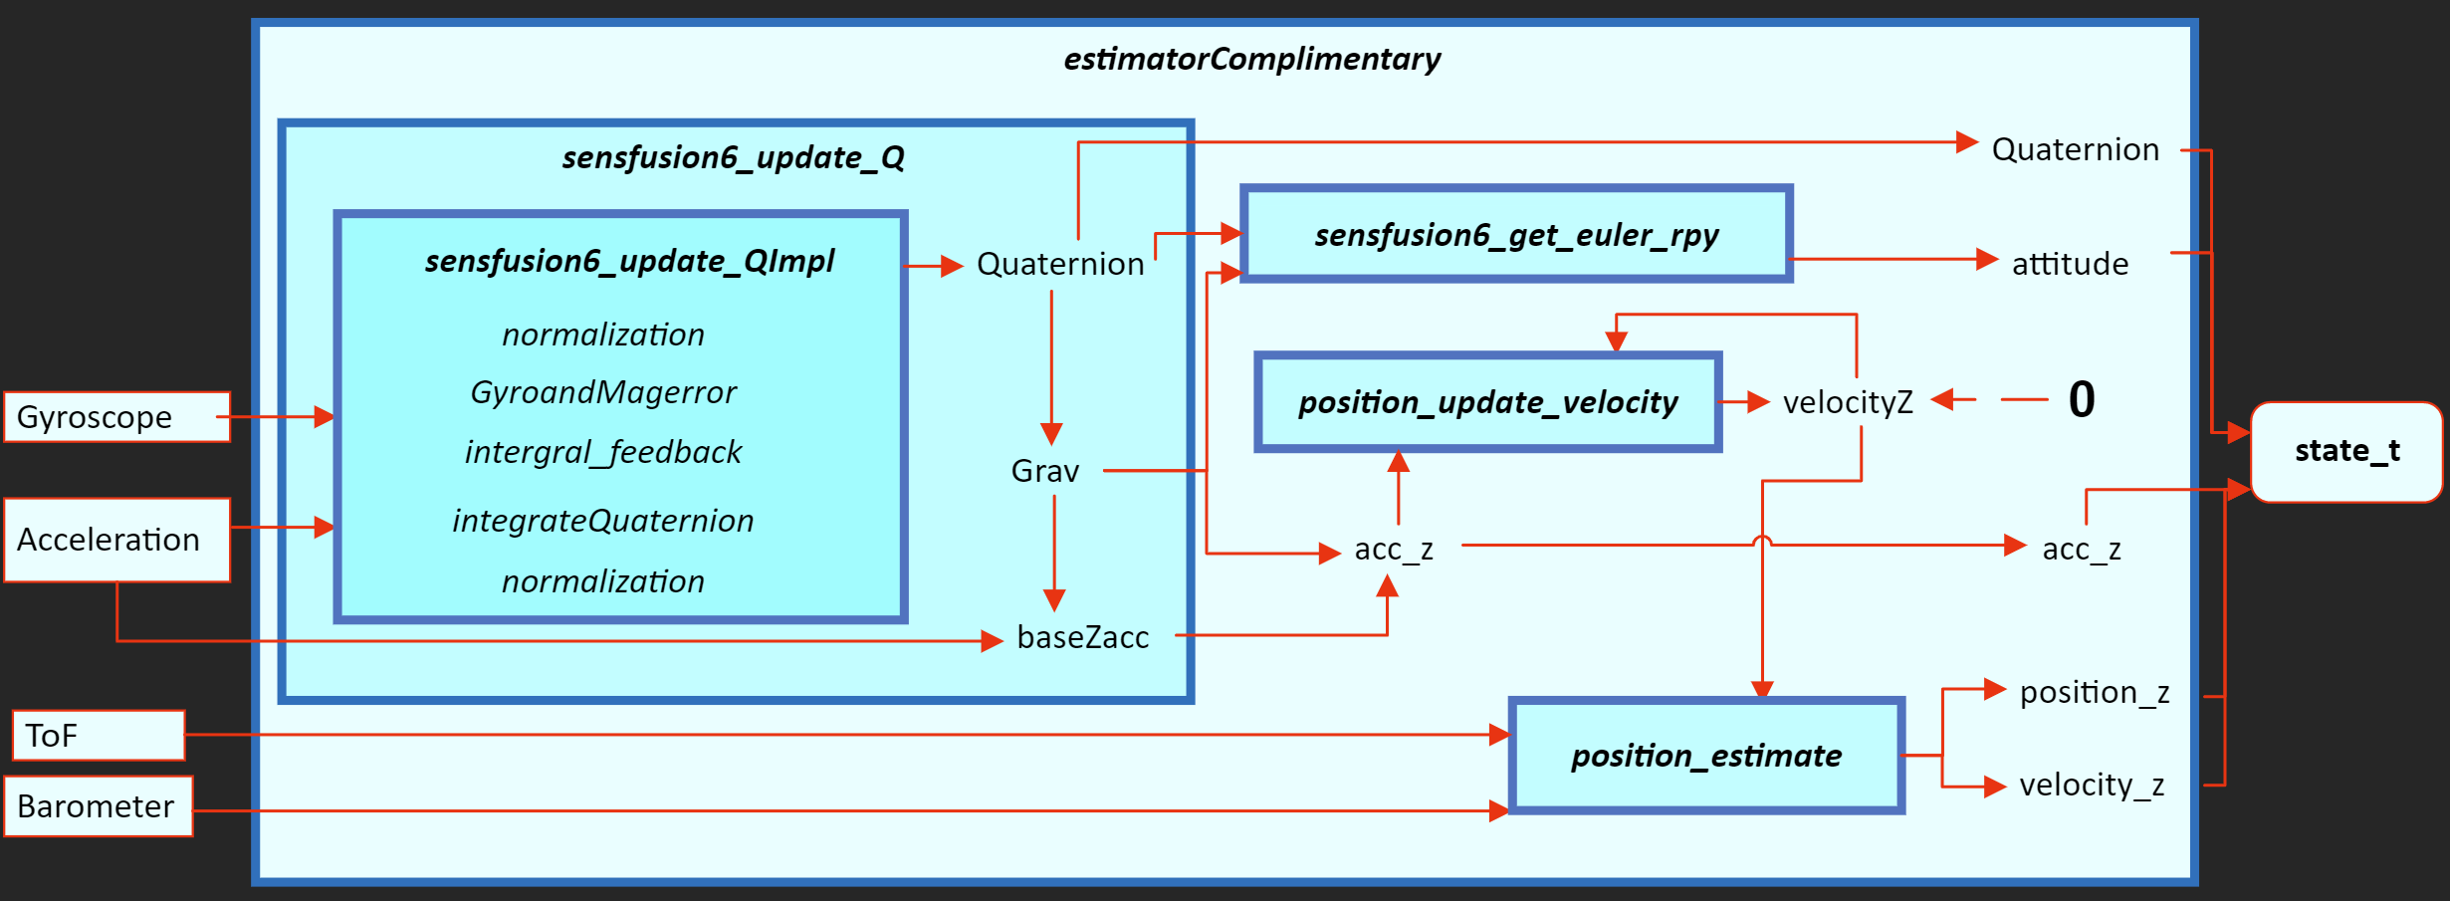
Complementary Filter Dataflow diagram
11

Slide 12
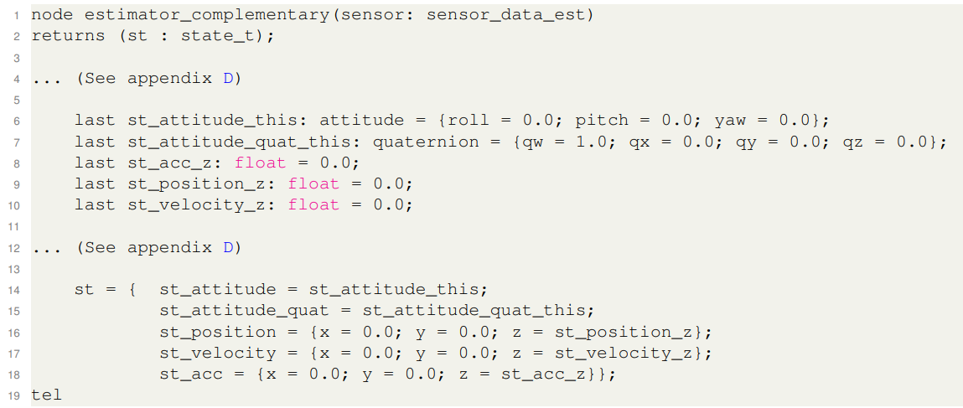
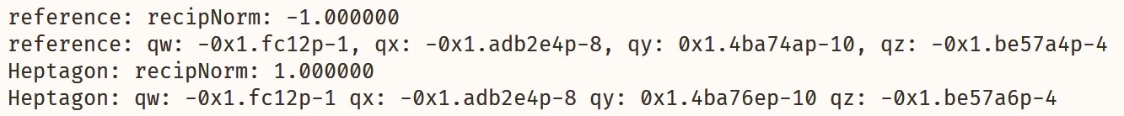
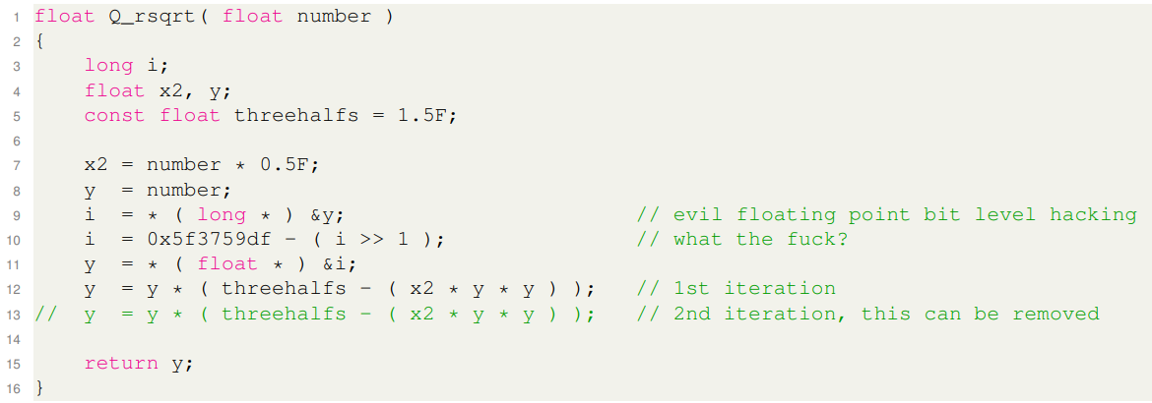
Complementary Filter Debugging
12
Debug testing environment
Bug in Heptagon compiler
Fast inverse square root and Floating-point numbers

Slide 13
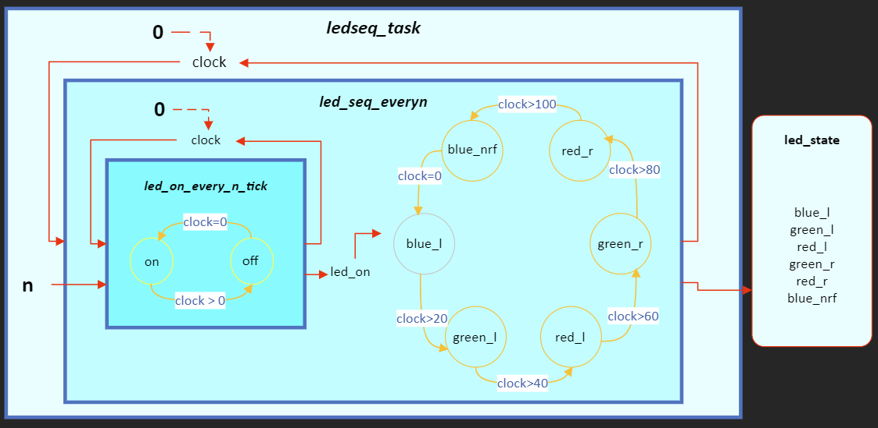
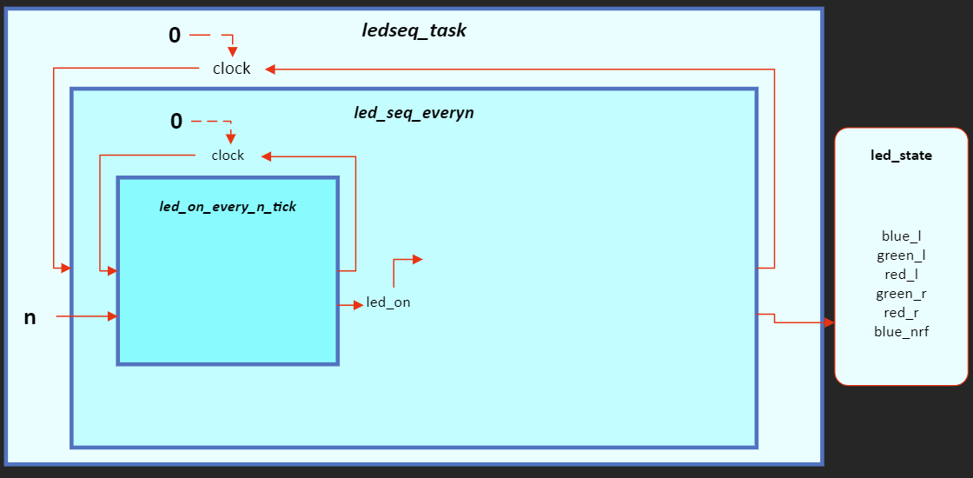
Led Seq Dataflow diagram
13
Final output
Internal timers
State machines

Slide 14
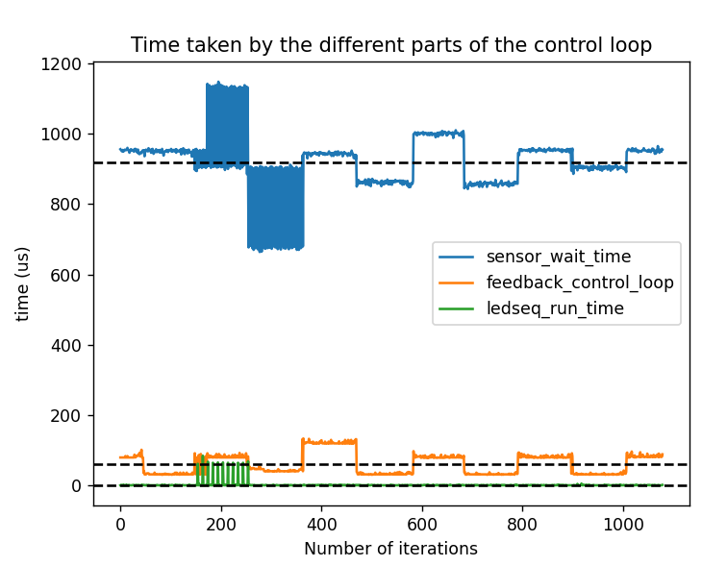
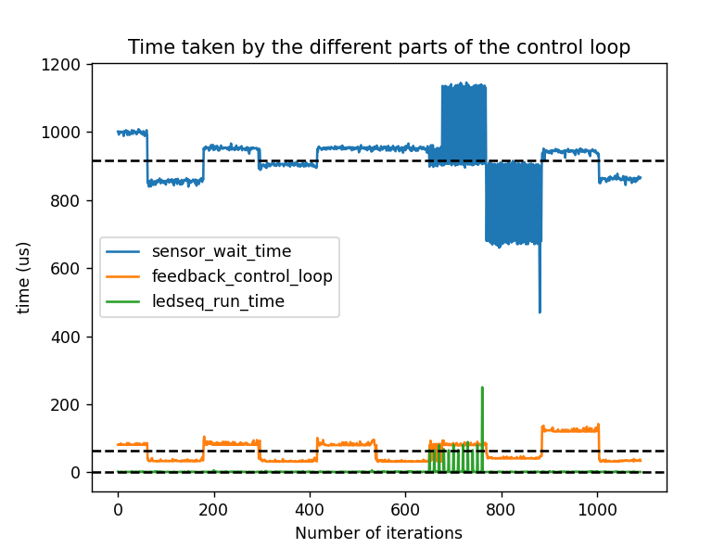
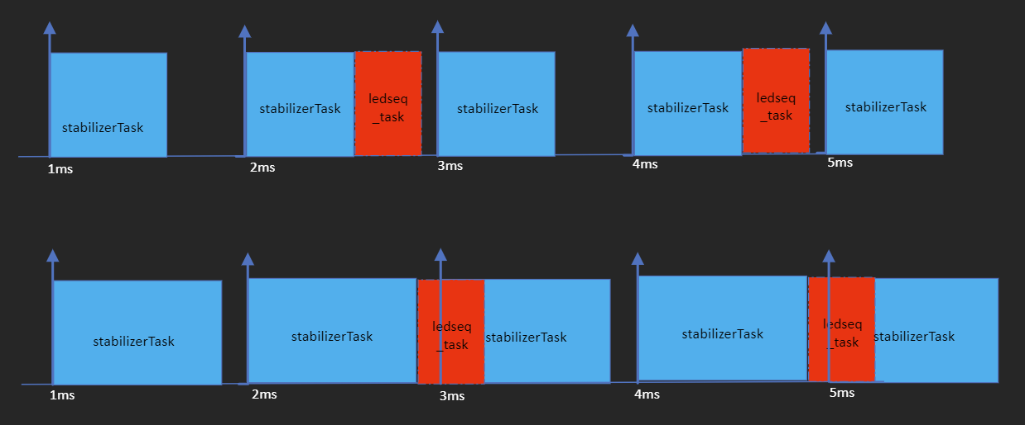
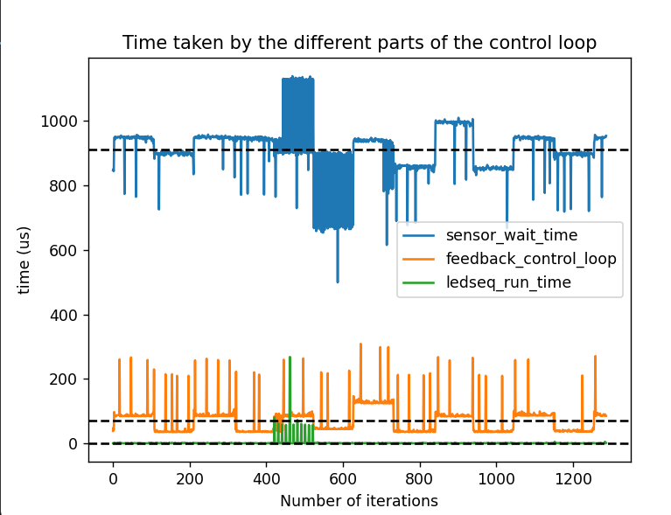
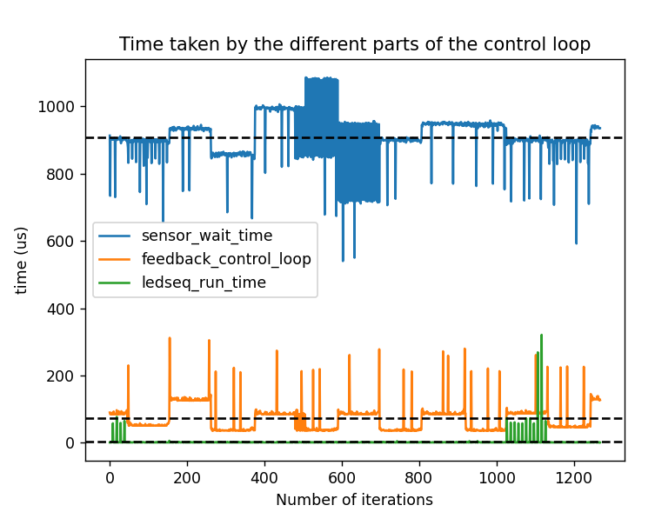
Led sequence FreeRTOS task analysis
14
Possible task running time can vary as show in the diagram
Timing aspect analysis

Slide 15
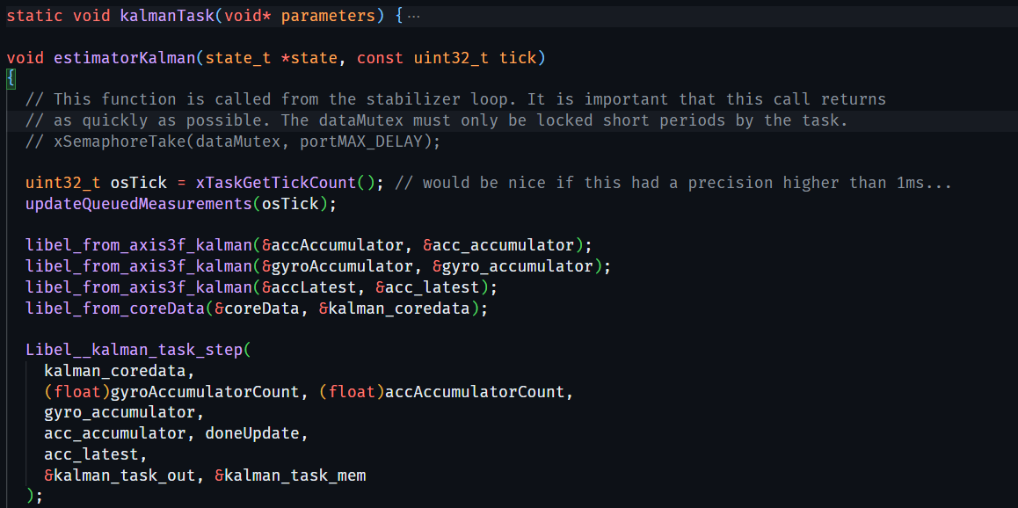
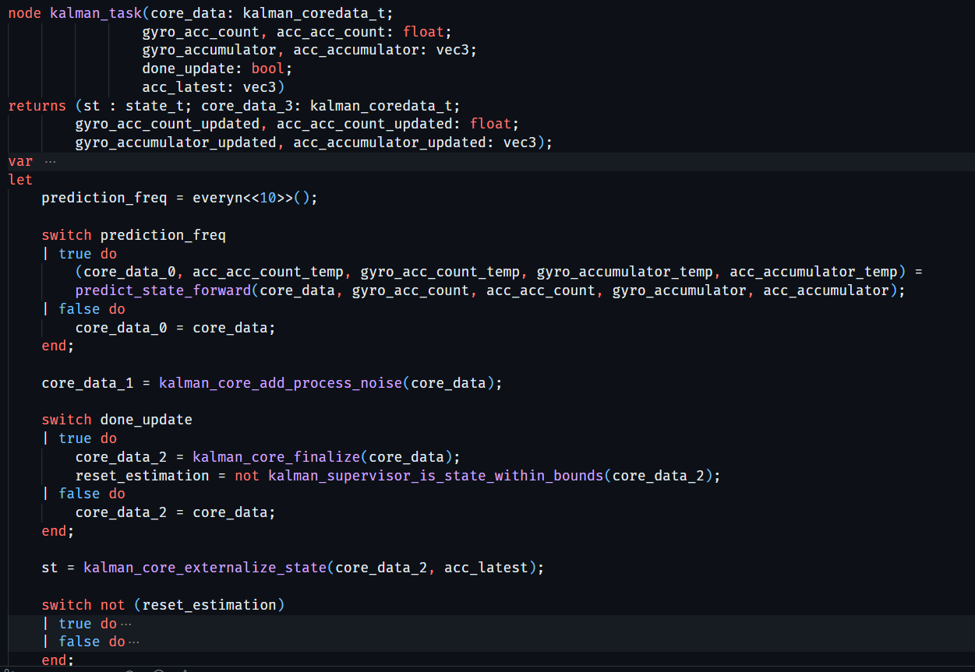
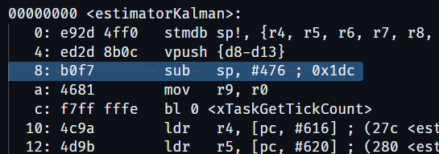
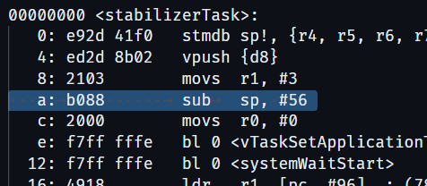
Extended Kalman Filter
15
Rearranging code
Issues with stack pointer debugged using disassembly

Slide 16
Conclusion
16
Results
Parts of feedback control loop and FreeRTOS tasks (led sequence) were successfully implemented as Heptagon nodes
Dataflow diagrams from Heptagon can be used to generate the low-level C code
Further Steps
Extended Kalman Filter can be debugged and integrated in the firmware.
Other FreeRTOS tasks including the High-Level Commander can be integrated as Heptagon nodes.

Slide 17
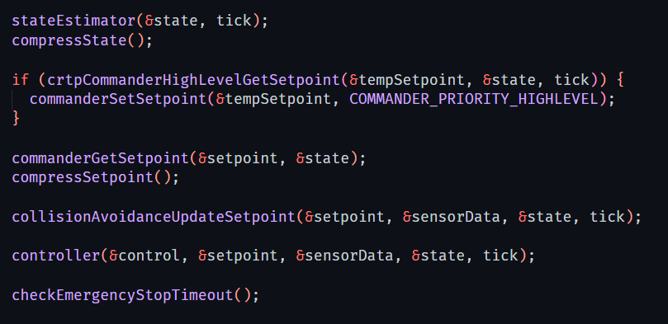
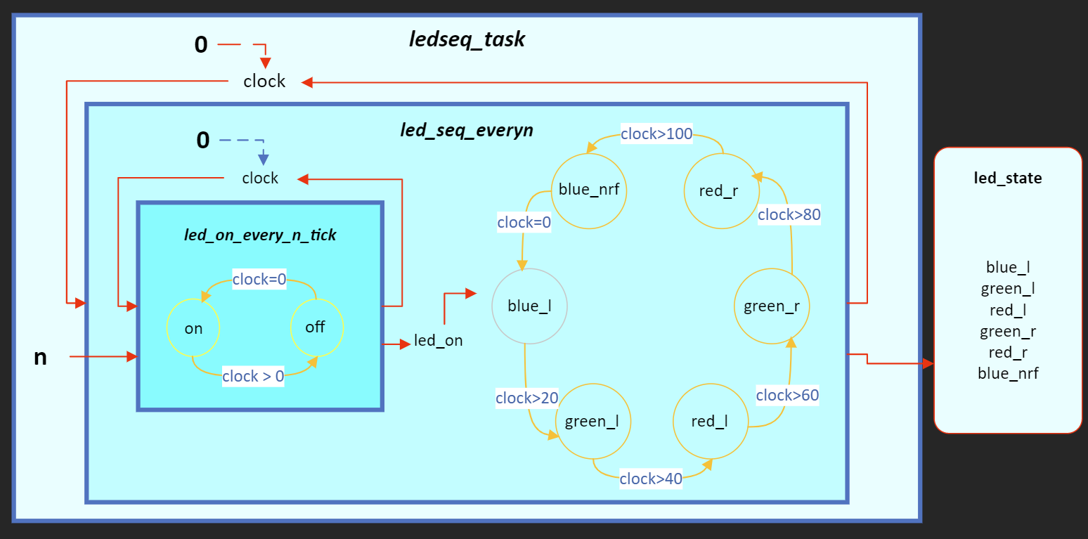
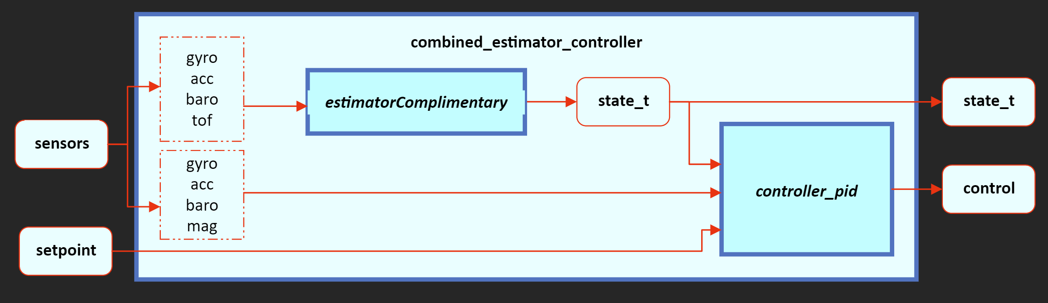
Thank You

